Slide 1
Applied Unsupervised Machine Learning
Soumya Banerjee

Slide 2
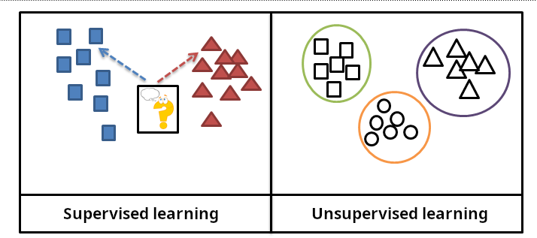
Types of Machine Learning
Slide courtesy Paul Fannon

Slide 3
Supervised Learning - Regression
Student | ML Trained? | Cohort %ile | Salary
0001 | Y | 12 | 120000
0002 | Y | 58 | 42000
0003 | N | 22 | 36000
0004 | Y | 58 | 35000
… | … | … | …
1784 | Y | 34 | ???
Slide courtesy Paul Fannon

Slide 4
Unsupervised methods
History
Exploratory data analysis
Hypothesis generation
Data visualization
Data imputation
Detecting outliers
Reduce “dimensions” or ”features”
Notes:
Slide on single-cell rna seq tsne xx
Slide on bulk seq data

Slide 5
High-dimensional data
How to visualize high-dimensional data?
Pairwise

Slide 6

High-dimensional data
https://stats.stackexchange.com/questions/2691/making-sense-of-principal-component-analysis-eigenvectors-eigenvalues

Slide 7
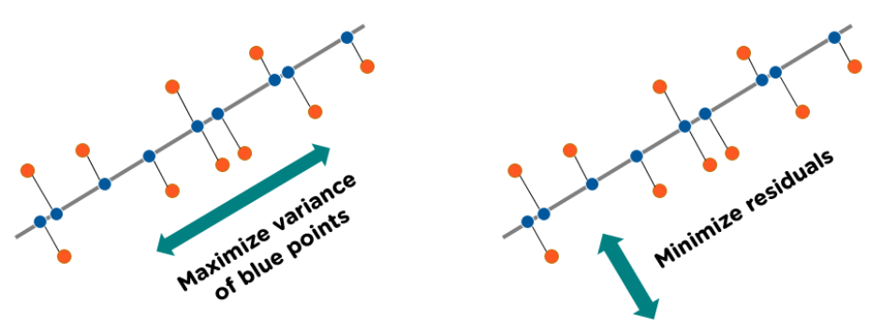
Concept
https://www.simplilearn.com/tutorials/machine-learning-tutorial/principal-component-analysis

Slide 8
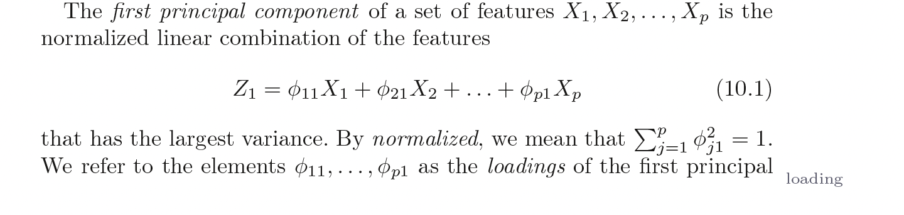
PCA
Introduction to Statistical Learning in R

Slide 9
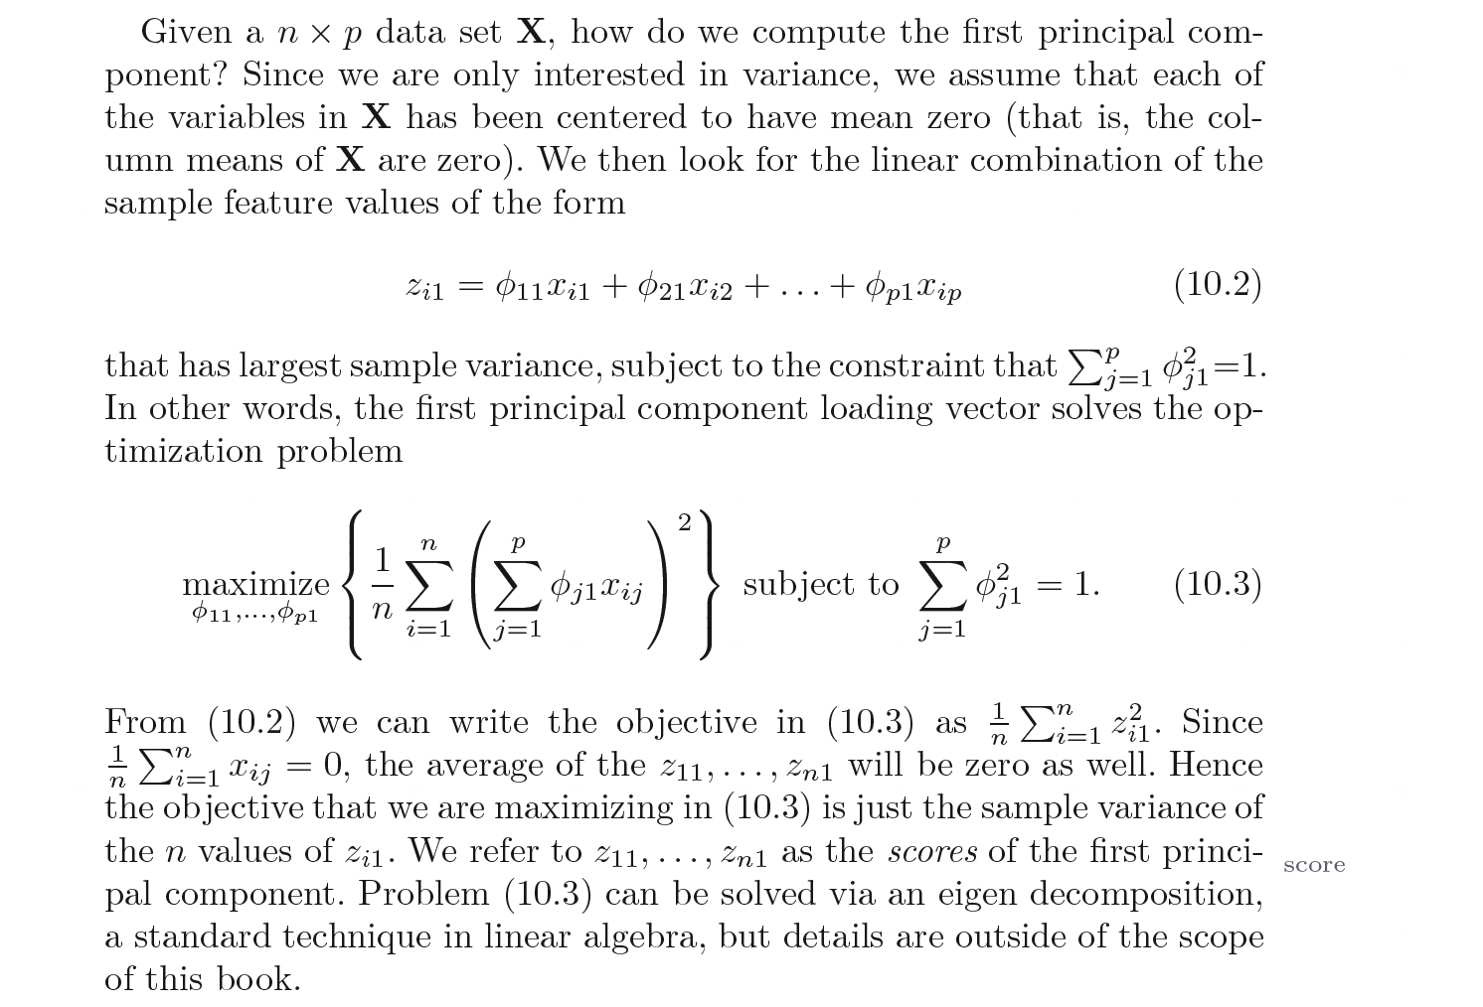
PCA
Introduction to Statistical Learning in R

Slide 10
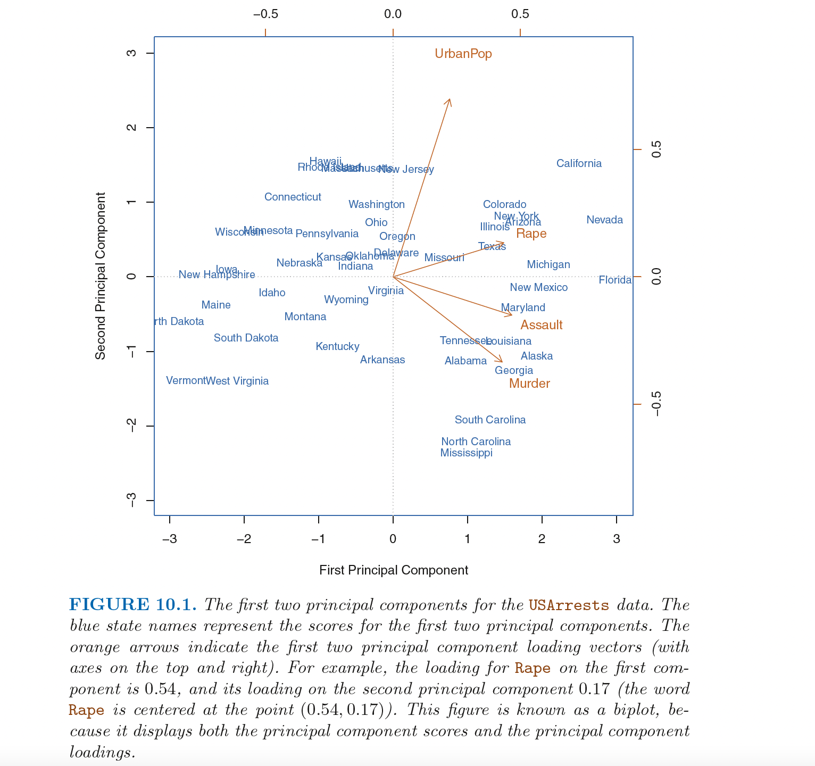

Slide 11
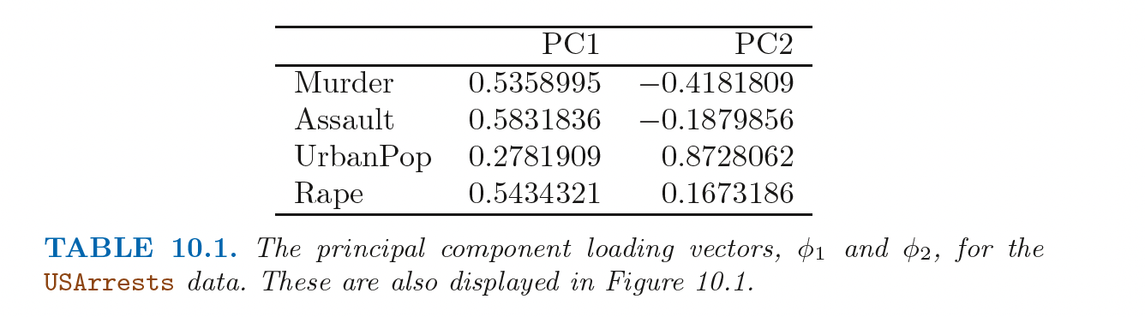
PCA
Introduction to Statistical Learning in R

Slide 12
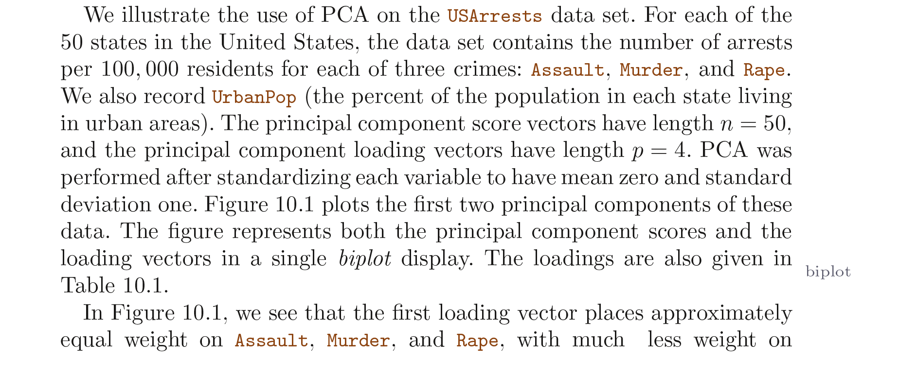
PCA
Introduction to Statistical Learning in R

Slide 13
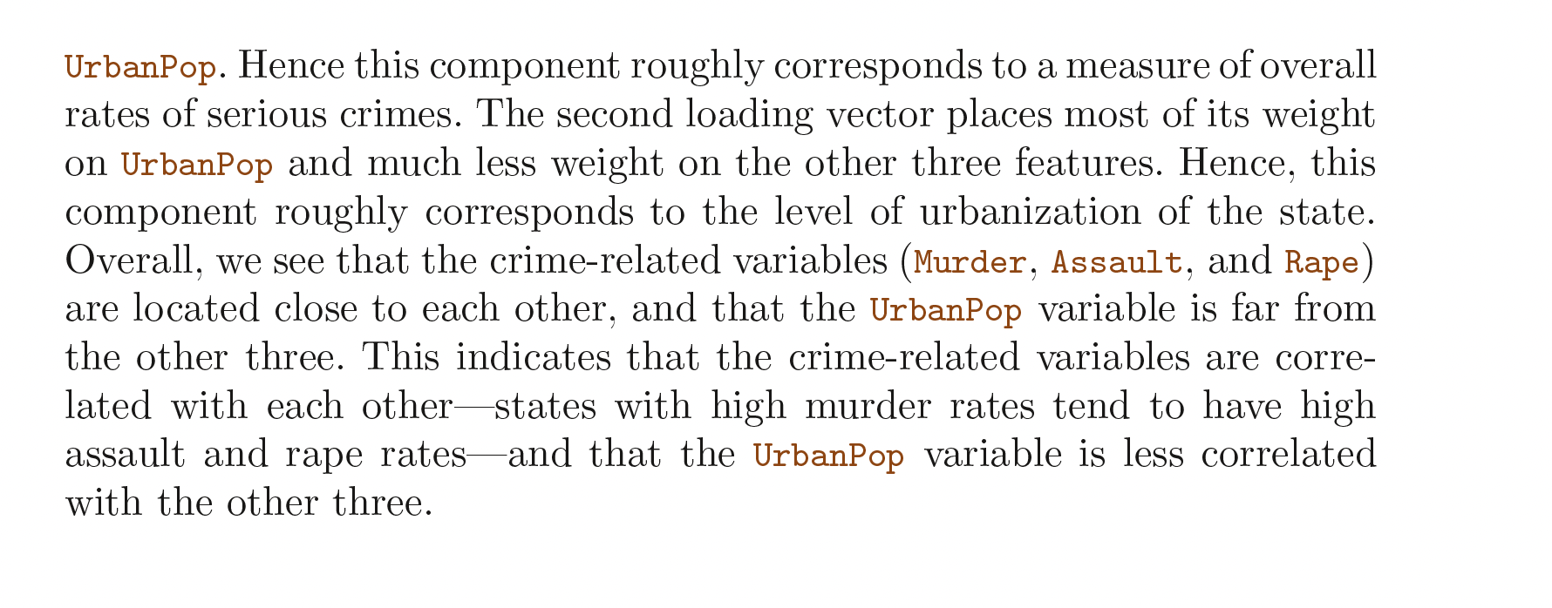
PCA
Introduction to Statistical Learning in R

Slide 14
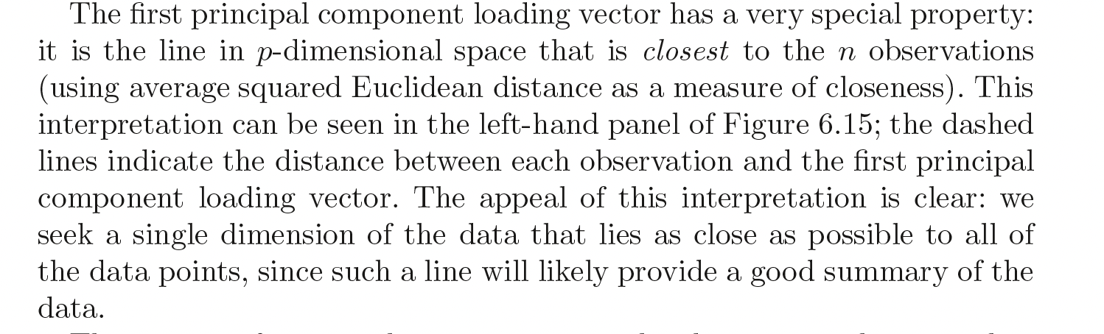
PCA
Introduction to Statistical Learning in R

Slide 15
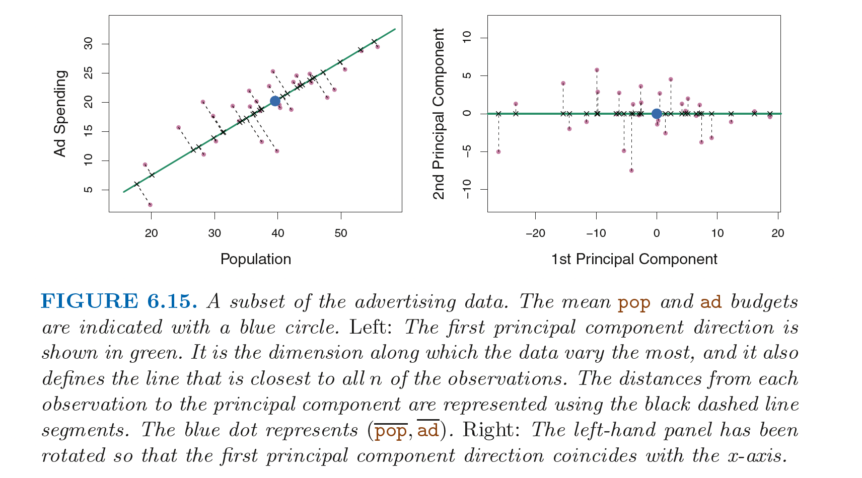
PCA
Introduction to Statistical Learning in R

Slide 16
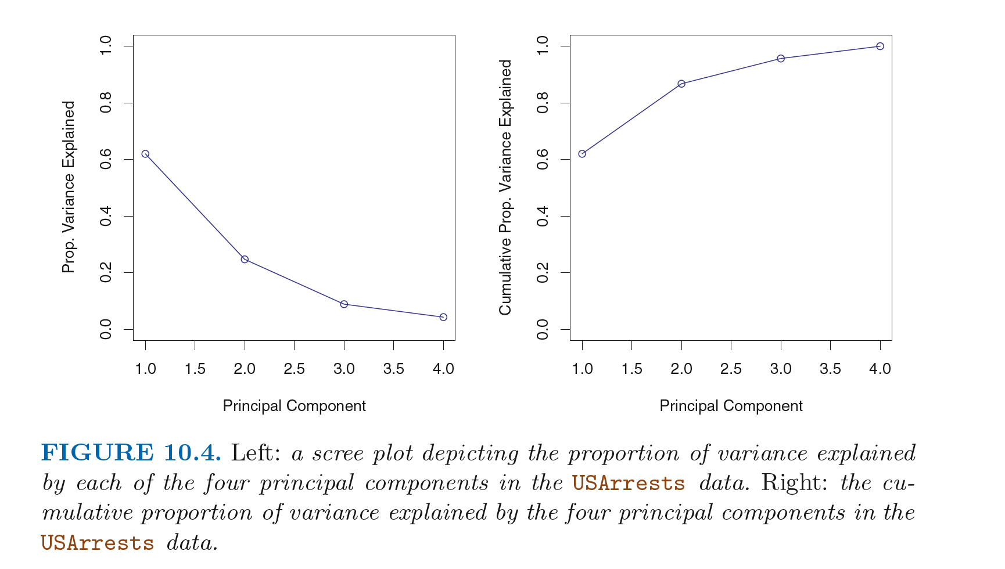
Scree plots (PRACTICAL)
Introduction to Statistical Learning in R

Slide 17

Interactive tool
https://projector.tensorflow.org/

Slide 18

Important concept
Information bottleneck
Introduction to Statistical Learning in R
Mathematics for Machine Learning by Marc Deisenroth
Notes:
This is how you achieve word embedding

Slide 19
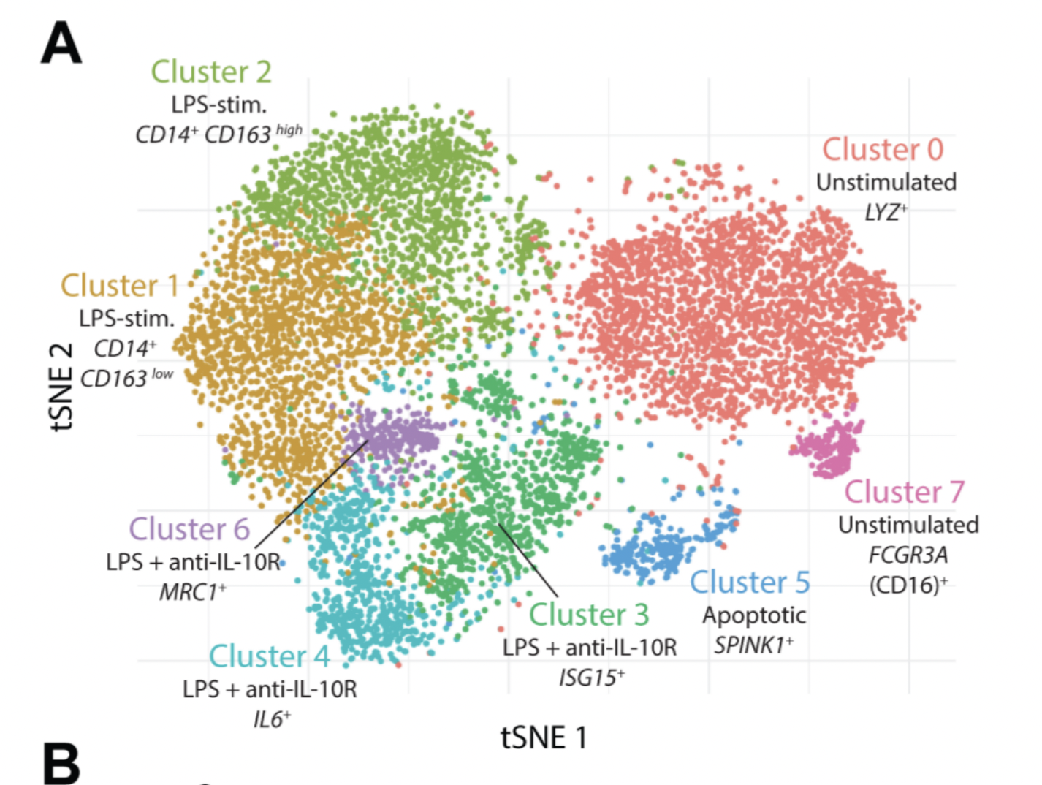
Case Study
a. stochastic b. distances not preserved c. difficult to communicate to non-technical experts
Deconvolution of monocyte responses in inflammatory bowel disease reveals an IL-1 cytokine network that regulates IL-23 in genetic and acquired IL-10 resistance Gut, 2020
Notes:
Example of IL10 project (tSNE and heatmaps from a bioinformatics project)

Slide 20
generalizations of this idea
tSNE
Autoencoder (non-linear loss function)

Slide 21
Visualizations can be misleading
1. distances not preserved in tsne
https://distill.pub/2016/misread-tsne/ 2. cluster sizes do not matter 3. you can see some shapes sometimes
4. random does not always look random
Notes:
Example of IL10 project (tSNE and heatmaps from a bioinformatics project)

Slide 22
1. problems with communicating high dimensional data 2. high dimensions are difficult to visualize
Visualizing high-dimensions
Notes:
Example of IL10 project (tSNE and heatmaps from a bioinformatics project)

Slide 23

Case study
Notes:
Example of IL10 project (tSNE and heatmaps from a bioinformatics project)

Slide 24
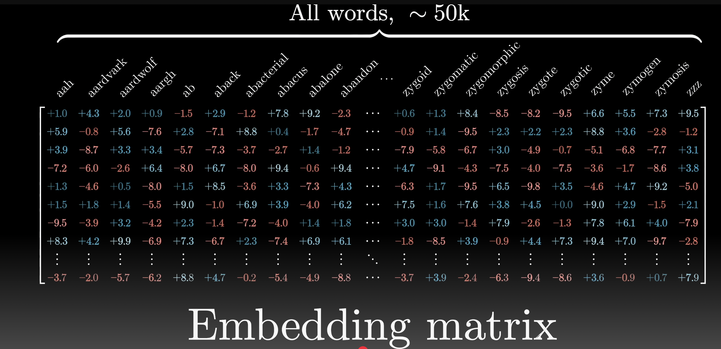
Applications to Large-Language Models
Video by 3blue1brown
Notes:
See autoencoder slide on how to achieve this

Slide 25
K means Clustering

Slide 26
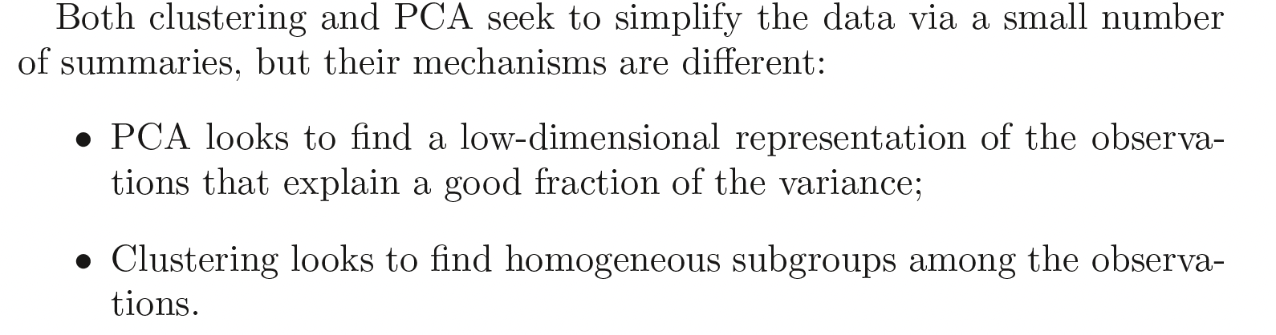
Clustering
Introduction to Statistical Learning in R

Slide 27
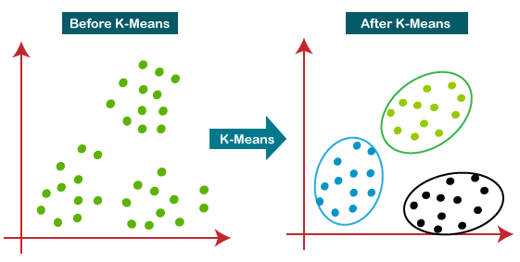
K-means Clustering
Slide courtesy Paul Fannon

Slide 28
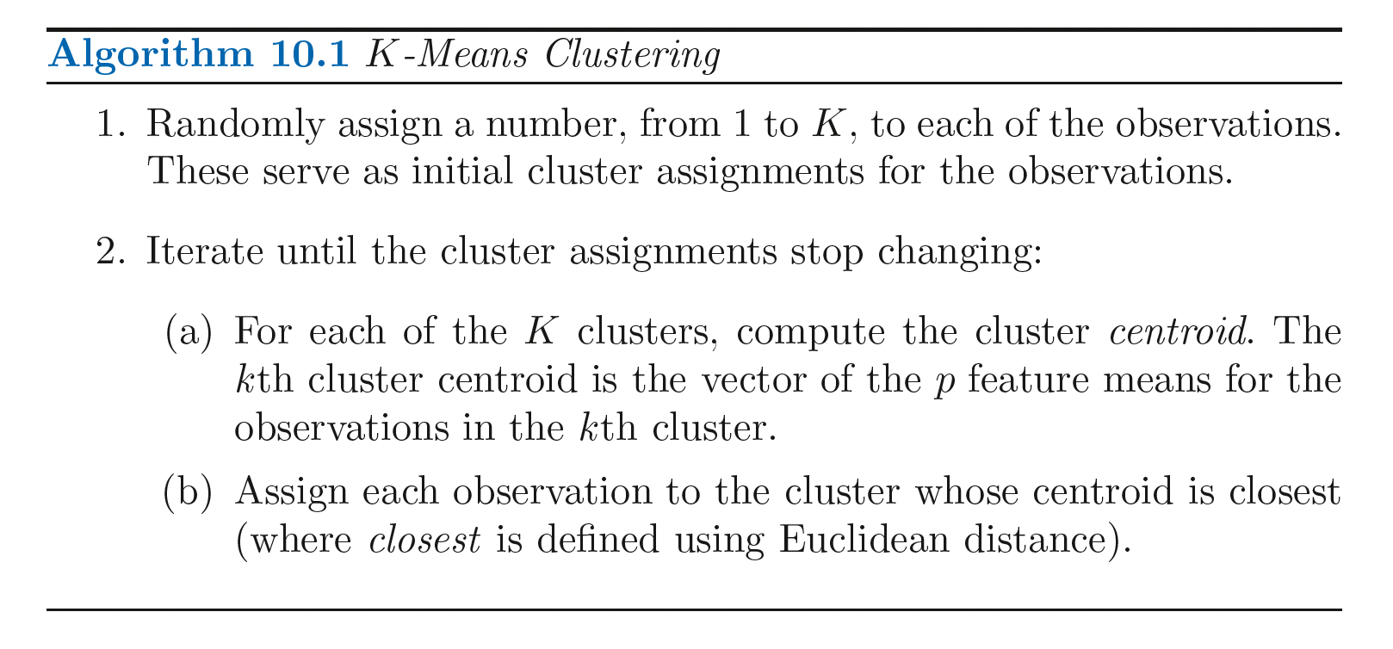
K-means Clustering
Introduction to Statistical Learning in R

Slide 29
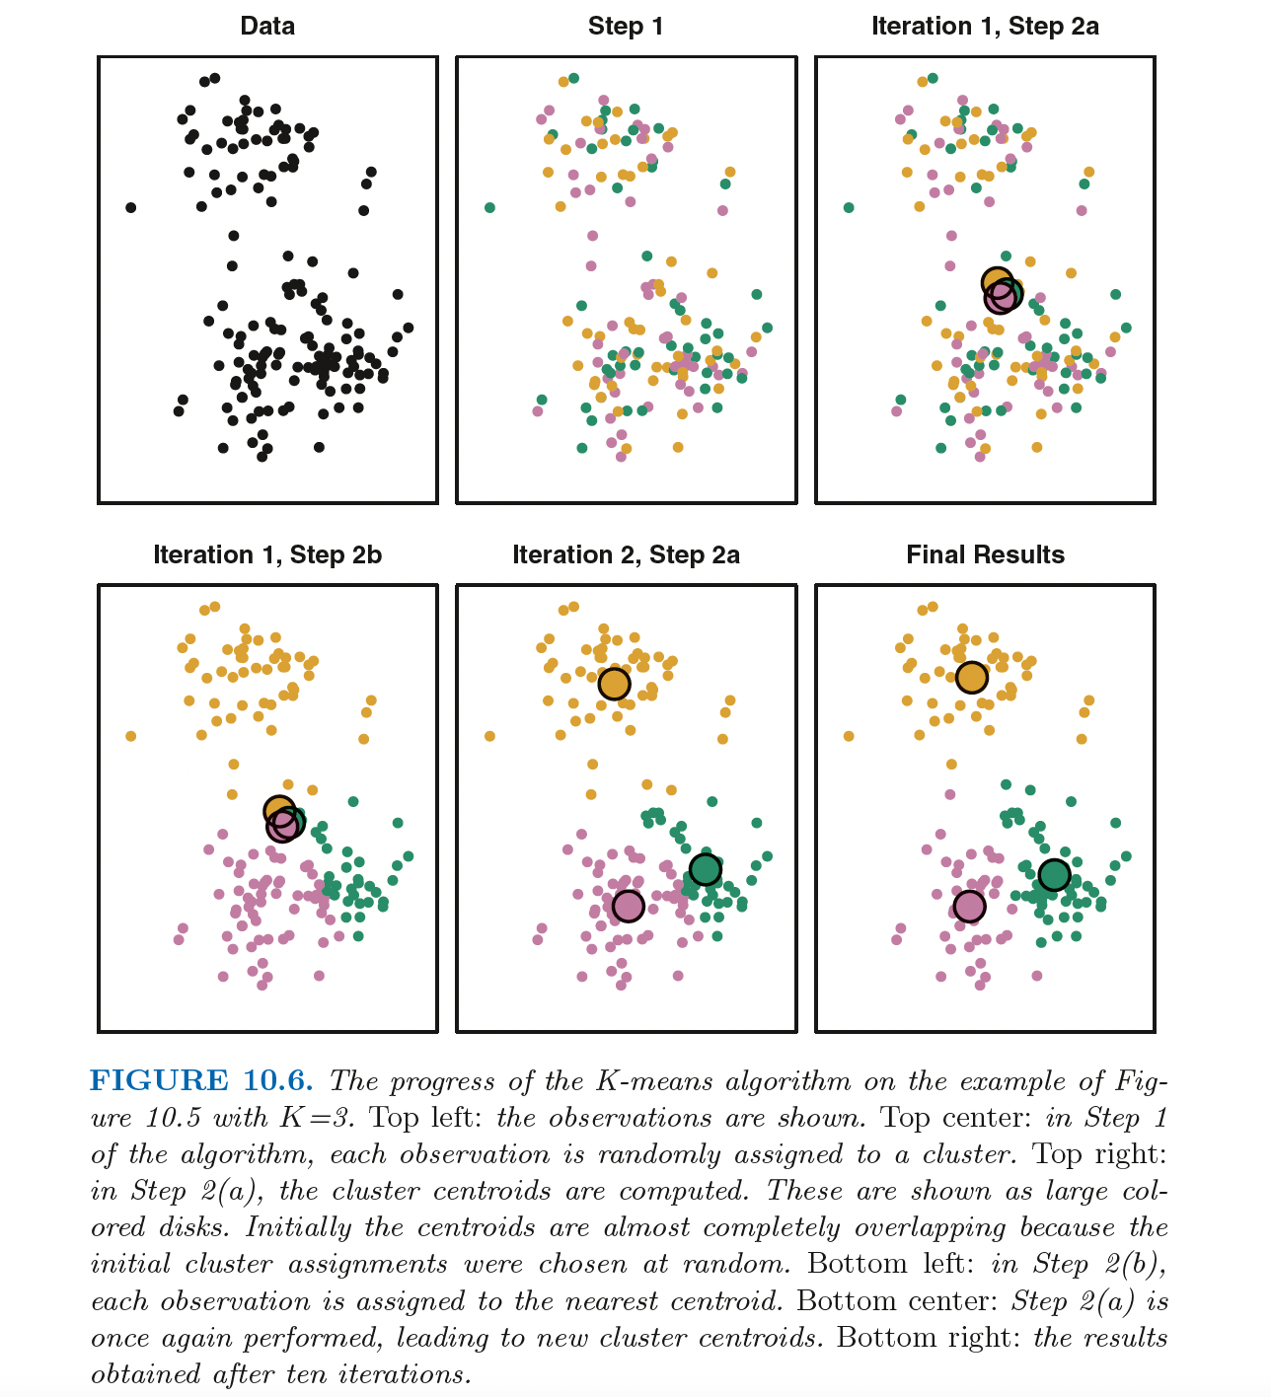
Introduction to Statistical Learning in R

Slide 30
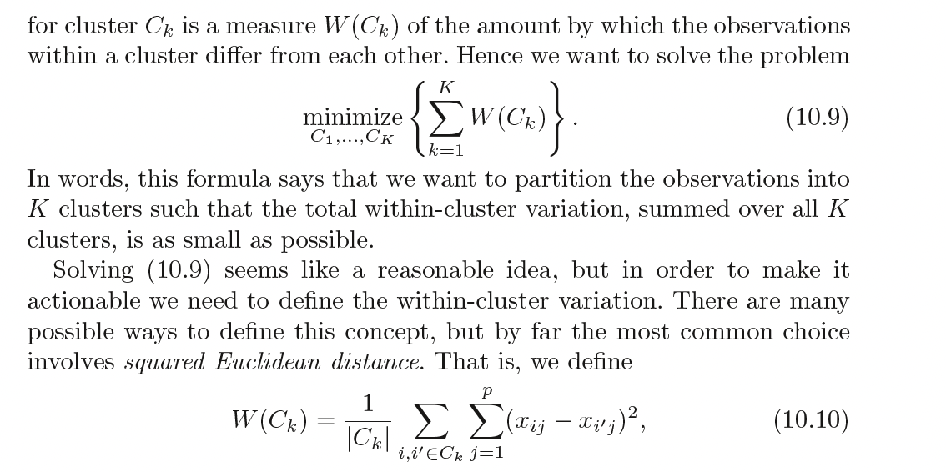
Introduction to Statistical Learning in R
Notes:
Stop when you minimize this

Slide 31
K-means Clustering
1. Assign each data point to their closest centroid.
2. Work out the mean of each resulting cluster and make this the new centroid.
https://www.youtube.com/watch?v=5I3Ei69I40s&ab_channel=bitLectures
https://www.youtube.com/watch?v=R2e3Ls9H_fc

Slide 32
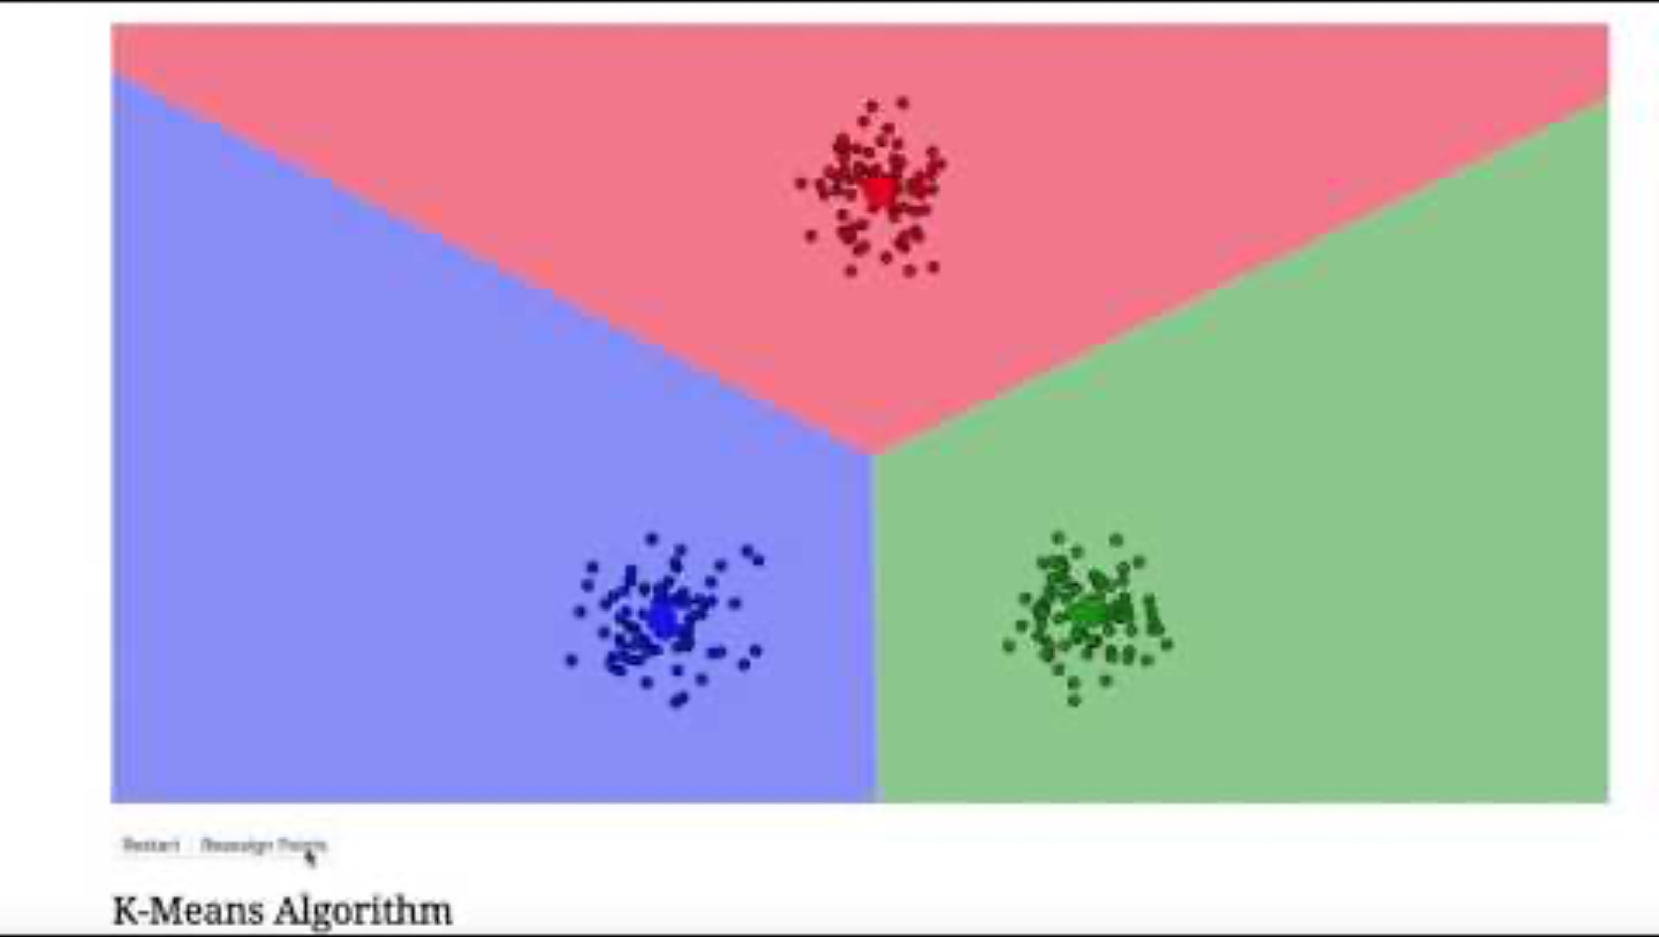
K-means Clustering

Slide 33
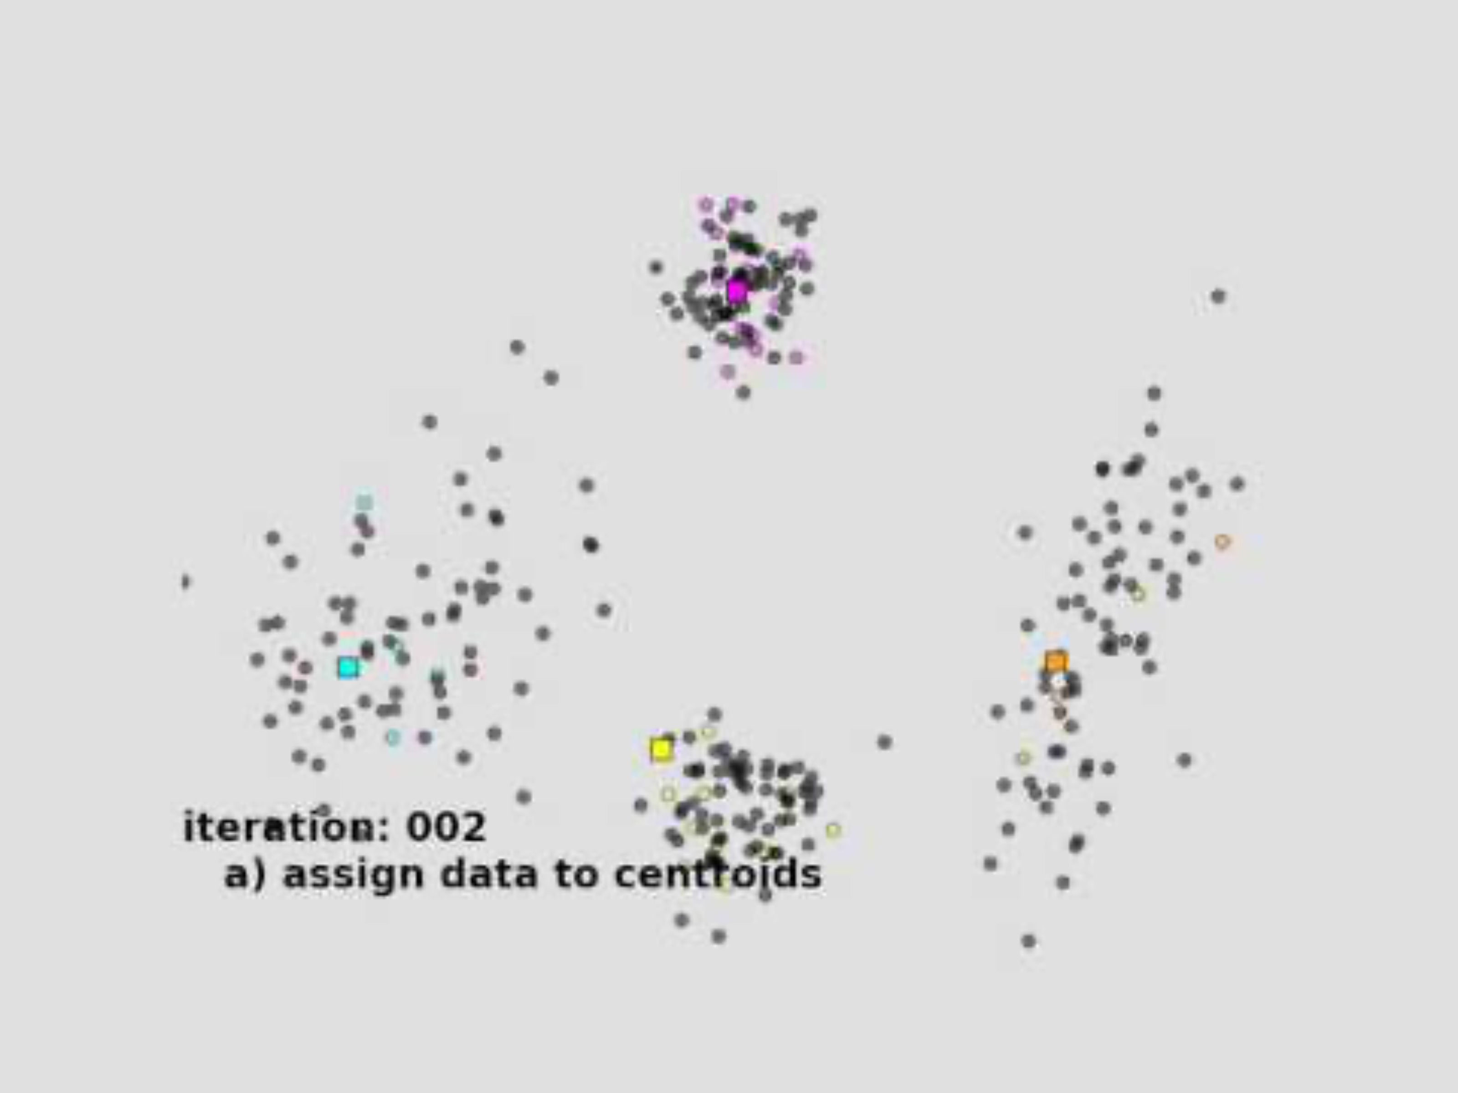
K-means Clustering

Slide 34
K-means Clustering
Can apply this to high-dimensional data (more than 2 variables/features)

Slide 35
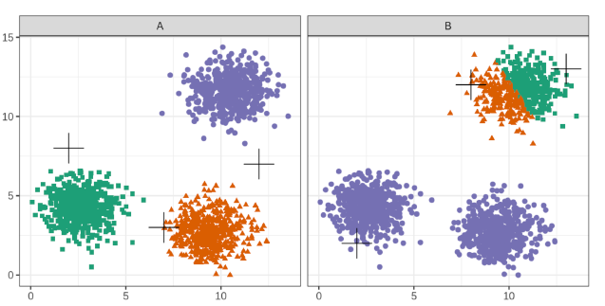
Choice of initial centroids
Slide courtesy Paul Fannon

Slide 36
Choosing k
Slide courtesy Paul Fannon

Slide 37
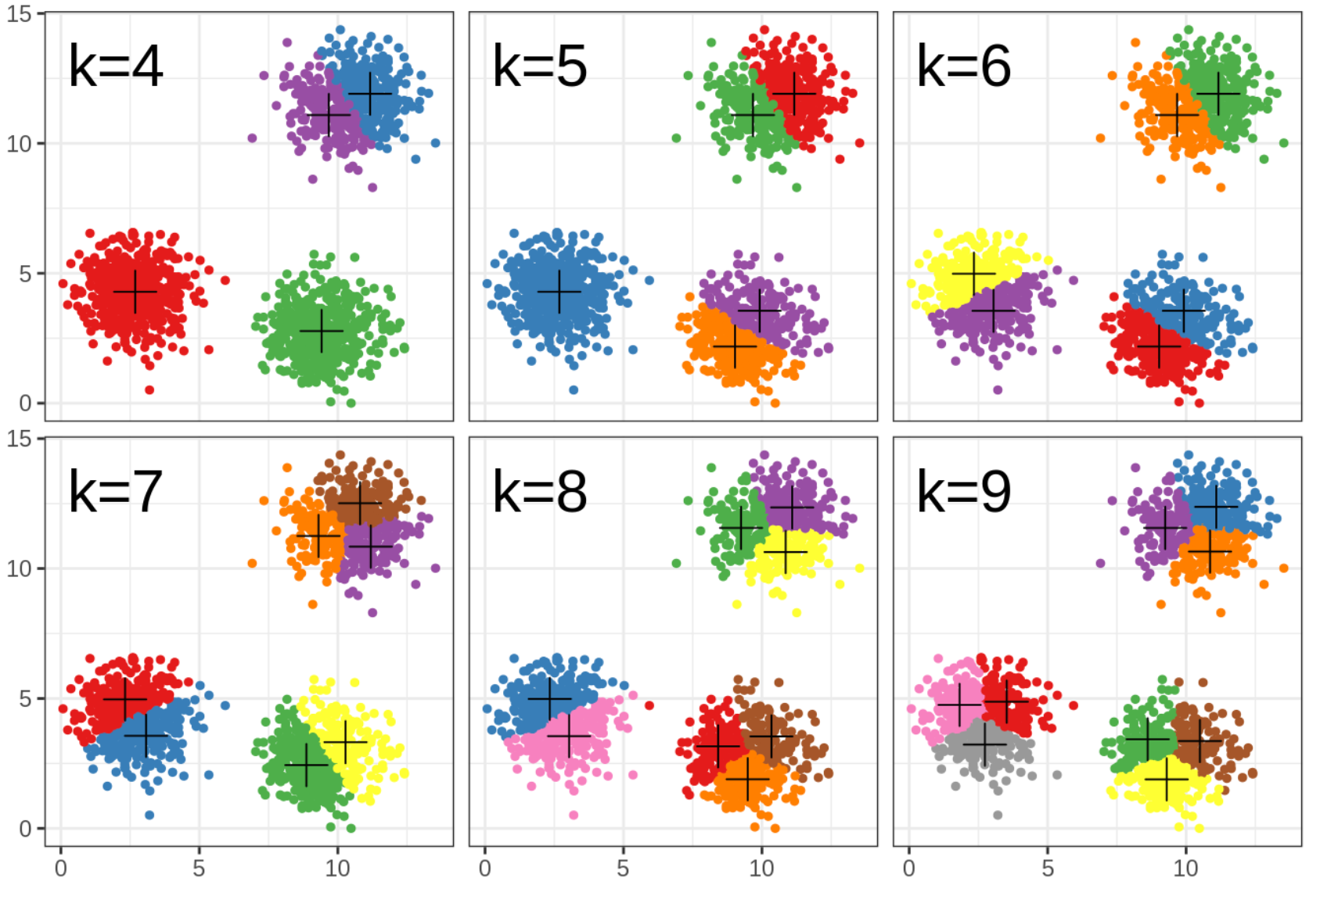
Choosing k
Slide courtesy Paul Fannon

Slide 38
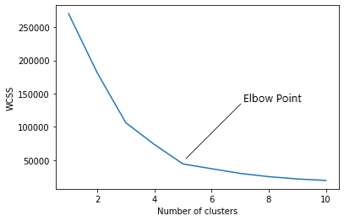
How to find the value of K
Slide courtesy Paul Fannon

Slide 39
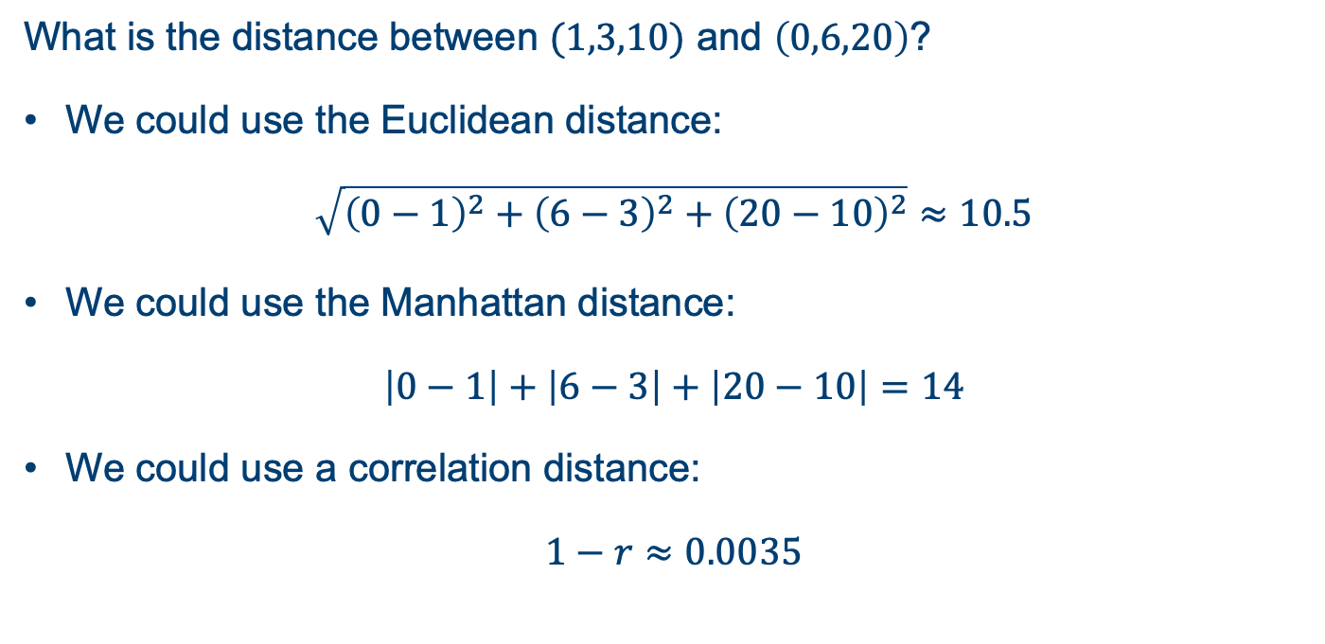
Clustering Distances
What is the distance between $(1,3,10)$ and $\left(0,6,20\right)$?
We could use the Euclidean distance:
$$\sqrt{{\left(0−1\right)}^{2}+{\left(6−3\right)}^{2}+{\left(20−10\right)}^{2}}≈10.5$$
We could use the Manhattan distance:
$$\left|0−1\right|+\left|6−3\right|+\left|20−10\right|=14$$
We could use a correlation distance:
$$1−r≈0.0035$$
Slide courtesy Paul Fannon

Slide 40
Hierarchical Clustering

Slide 41
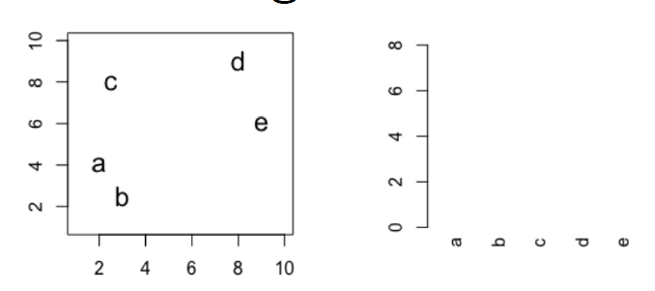
Hierarchical clustering
Slide courtesy Paul Fannon

Slide 42
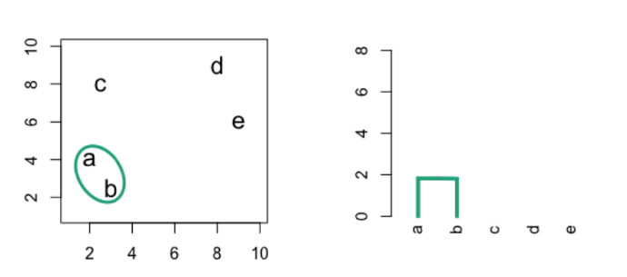
Hierarchical clustering
Slide courtesy Paul Fannon

Slide 43
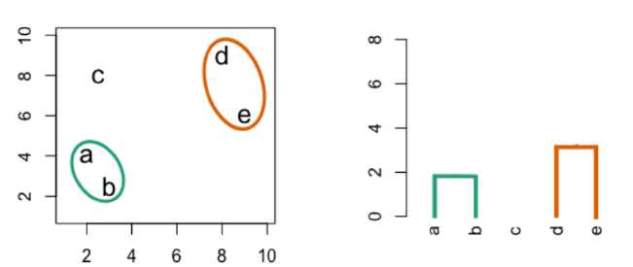
Hierarchical clustering
Slide courtesy Paul Fannon

Slide 44
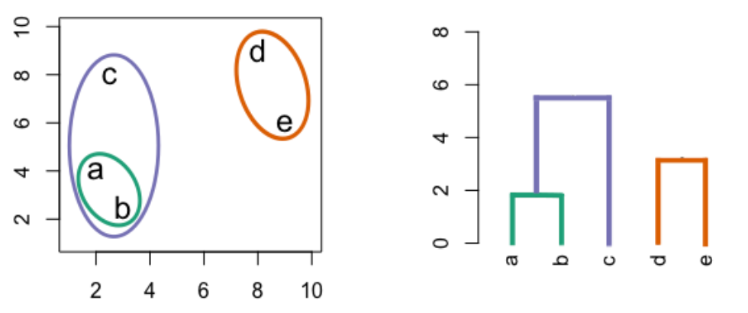
Hierarchical clustering
Slide courtesy Paul Fannon

Slide 45
Hierarchical clustering
Slide courtesy Paul Fannon

Slide 46
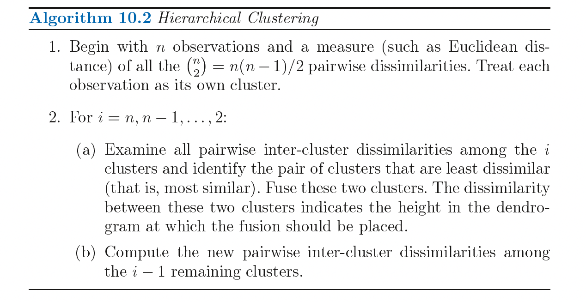
Hierarchical clustering
Introduction to Statistical Learning in R

Slide 47
Dissimilarity measures
Euclidean distance
Correlation based distance

Slide 48
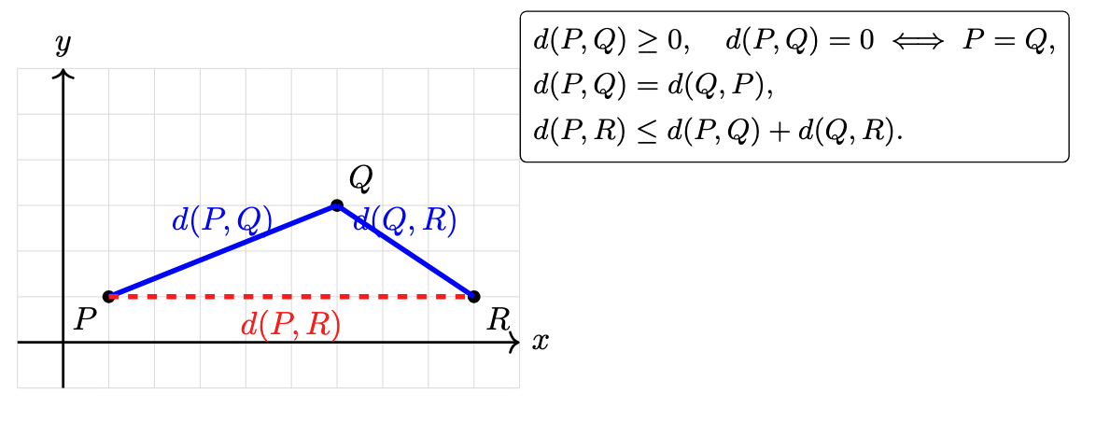
Dissimilarity measures

Slide 49
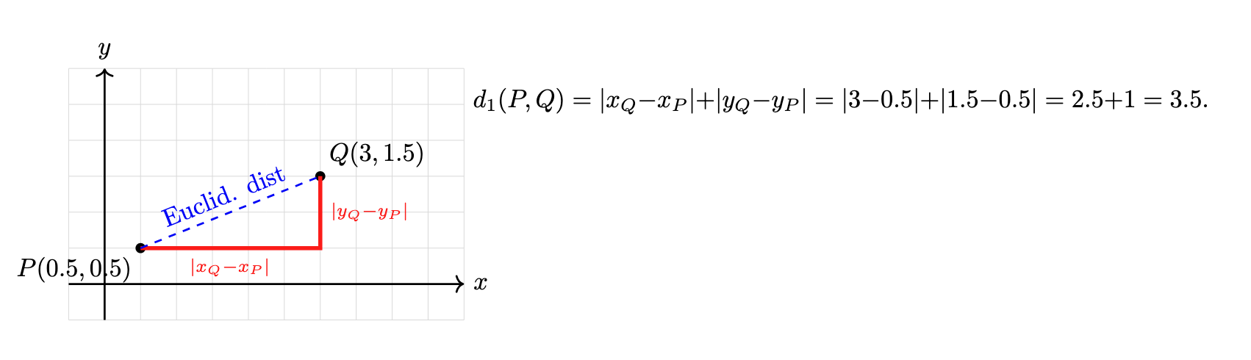
Dissimilarity measures

Slide 50
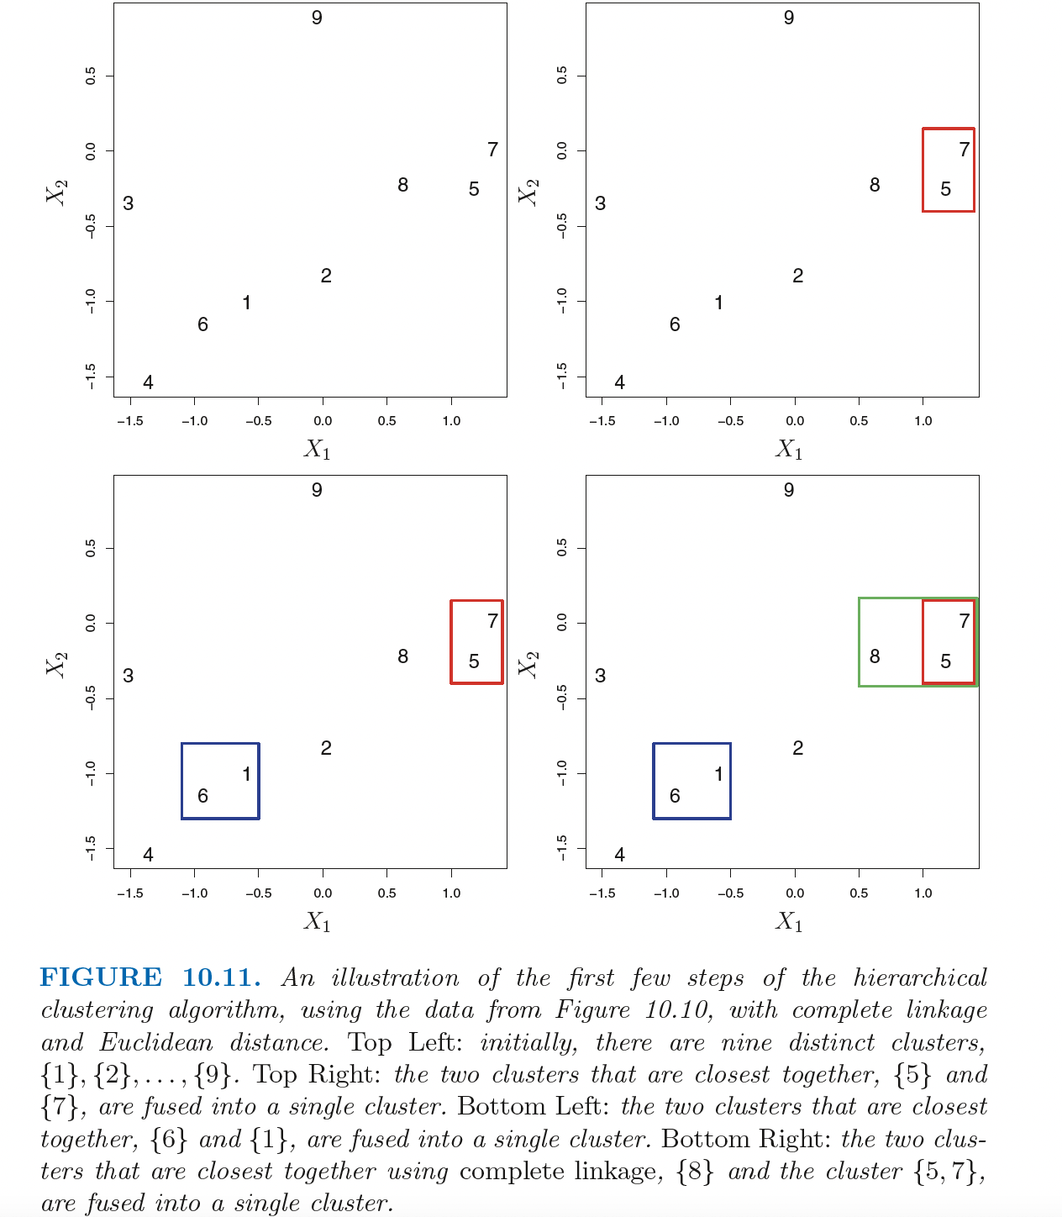
Dissimilarity measures
Introduction to Statistical Learning in R

Slide 51
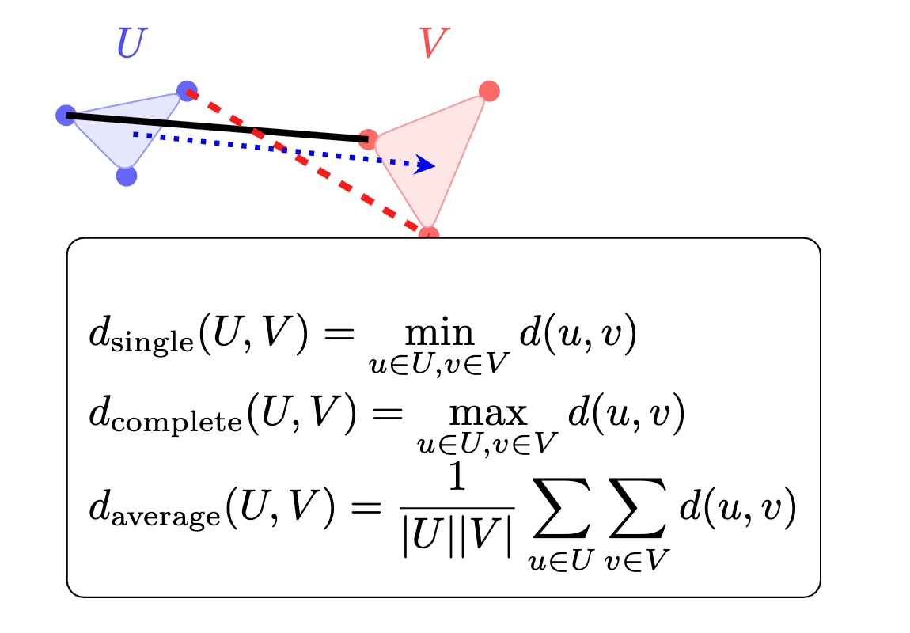
Linkage function

Slide 52
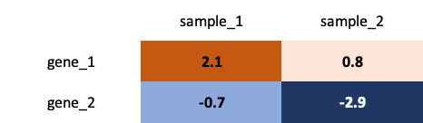
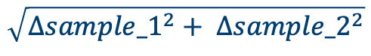

Defining “similarity” – between observations
Measure difference with:
Euclidian distance
Manhattan distance
Which one to choose? The one
that gives most insight!
$$\sqrt{{Δsample_1}^{2}+ {Δsample_2}^{2}}$$
$$\left|∆sample_{1}\right|+\left|∆sample_2\right|+|…|$$
Slide courtesy Martin van Rongen and Vicki Hodgson

Slide 53
Defining “similarity”
We have choices about how to define “similarity” at multiple stages:
Between observations (Euclidean, Manhattan)
Between single points and clusters (linkage)
Slide courtesy Martin van Rongen and Vicki Hodgson

Slide 54
Defining “similarity” – between points & clusters
Slide courtesy Martin van Rongen and Vicki Hodgson
Average (centroid)
Single linkage – closest point
Complete linkage – furthest point

Slide 55
Defining “similarity”
We have choices about how to define “similarity” at multiple stages:
Between observations (Euclidean, Manhattan)
Between single points and clusters (linkage)
Between clusters – useful to assess overall clustering quality (elbow, silhouette)
Slide courtesy Martin van Rongen and Vicki Hodgson

Slide 56
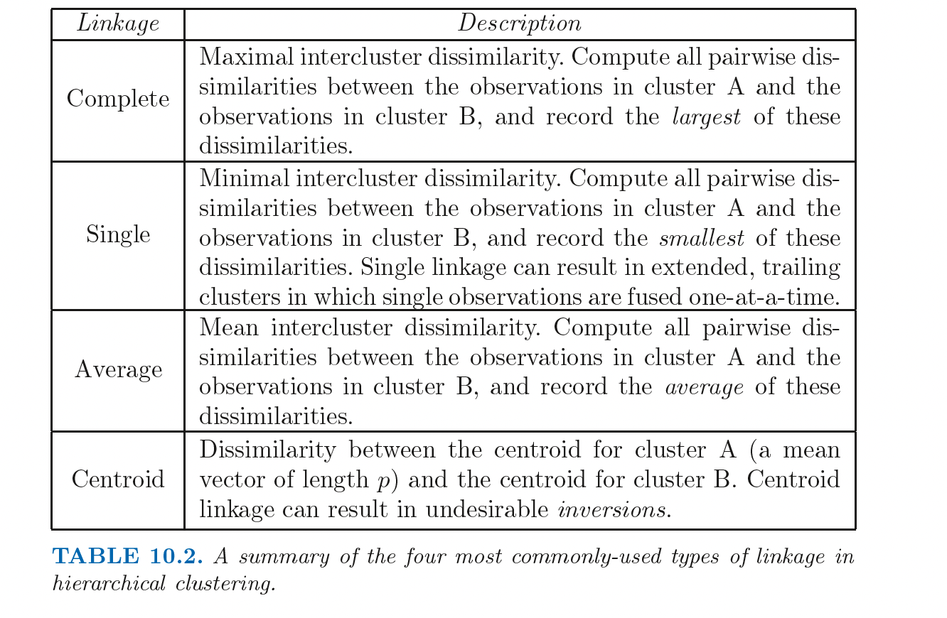
Linkage function
Introduction to Statistical Learning in R

Slide 57
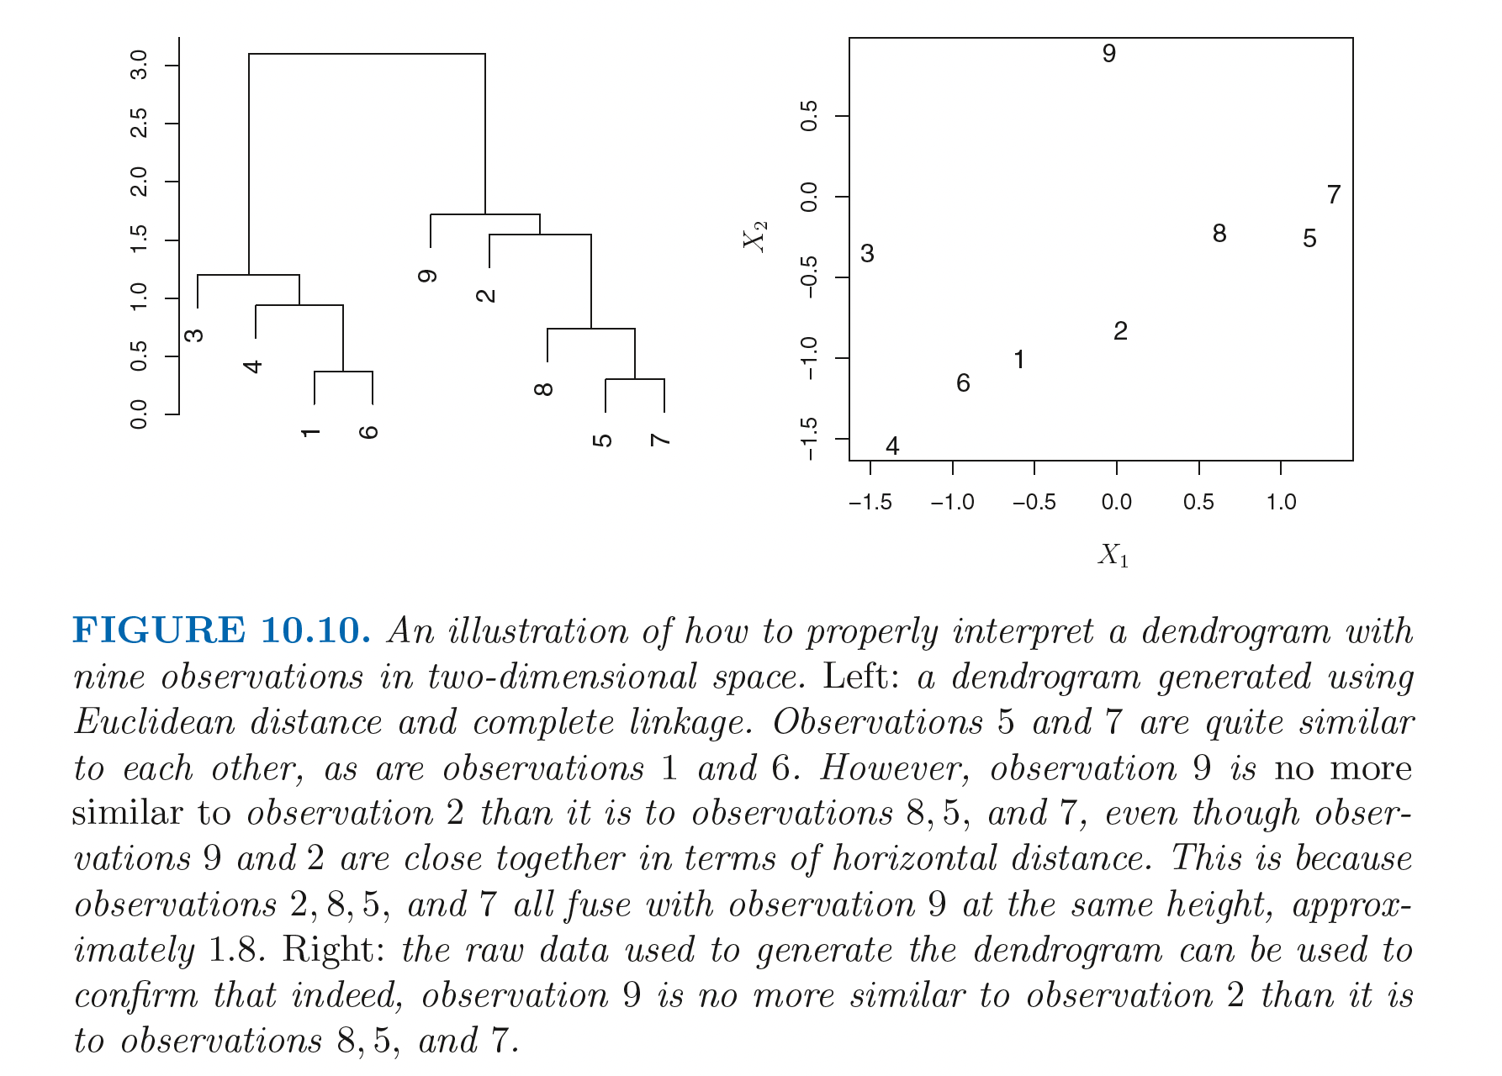
Trees
Introduction to Statistical Learning in R

Slide 58
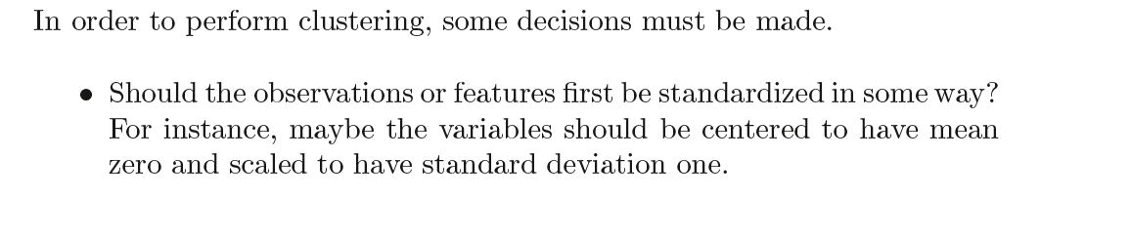
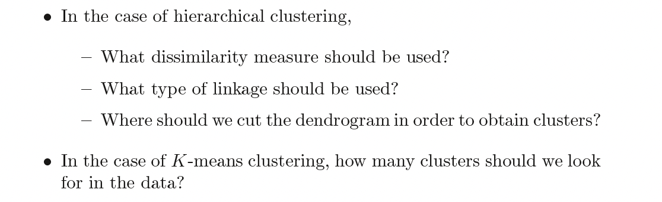
Decisions
Introduction to Statistical Learning in R

Slide 59
Validating clusters
Utility of unsupervised machine learning
Validate clusters in external dataset
Hypothesis generation
Try running algorithms with many different “settings”

Slide 60
Resources
https://github.com/neelsoumya/public_teaching_unsupervised_learning
https://www.statlearning.com/
https://cambiotraining.github.io/ml-unsupervised/

Slide 61
Validating clusters

